Slide 1
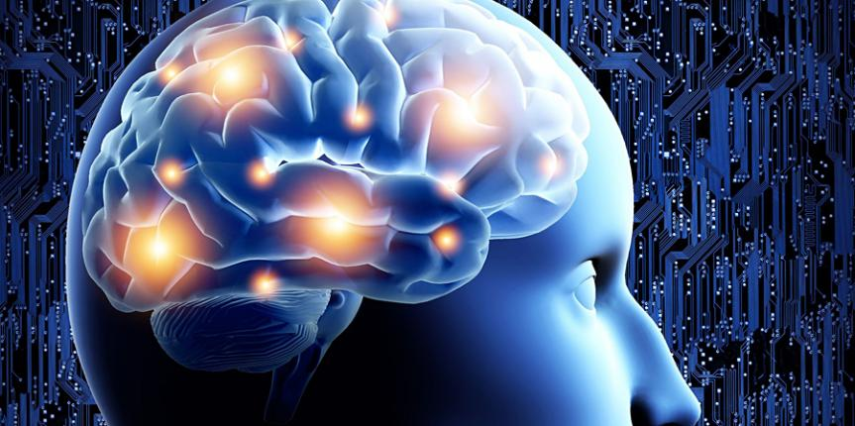
Emotions and the Body How to understand your body’s messages

Slide 2
Overview
Stress and its effects on the mind and body:
The emotional brain –limbic system
Stress response – HPA axis
Autonomic Nervous System
Polyvagal theory
Childhood trauma – ACE’s
Gut-brain
Heart-brain
Chronic disease
Healing and recovery
Demo – EFT if time...

Slide 3
Stress: Definition What is stress?
Something that takes you out of balance (homeostasis)
Causes your mindbody to enact the stress response
Should be temporary and short-lived
Examples:
Accident
Divorce
Bereavement
But chronic stress is much more important biologically..
Bullying, separation, anxiety, illness itself
Notes:
And if you’ve suffered from chronic stress in childhood those one-off experiences become so much worse.

Slide 4
Effects of stress: not all in your genes
Changes your brain to see threat more easily (kindling)
Stress response activation higher (lower resilience)
Lower threshold for cortisol hormone release
Suppress your immune response – disease*
Changes your DNA expression (epigenetics) towards inflammation
Reduces detoxification ability
*different outcome for every person depending on your weak link (genetic predisposition)

Slide 5
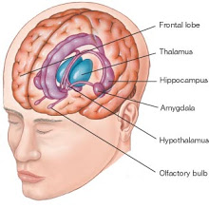
Stressful experience (emotional trauma) landscapes the brain and changes the mind and body – for life* *unless mitigated
Your emotional brain: Limbic system
Notes:
Meet your emotional brain [describe]
Amygdala is centre of fear – but it reacts to what is unfamiliar first and foremost – both internally and externally.
Stress and trauma landscape (change) the brain.
Especially early (childhood) trauma)
Bits grow (amygdala) and some bits shrink (hippocampus and frontal lobes) and because your deep emotional brain (limbic system) talks directly to your body via the

Slide 6
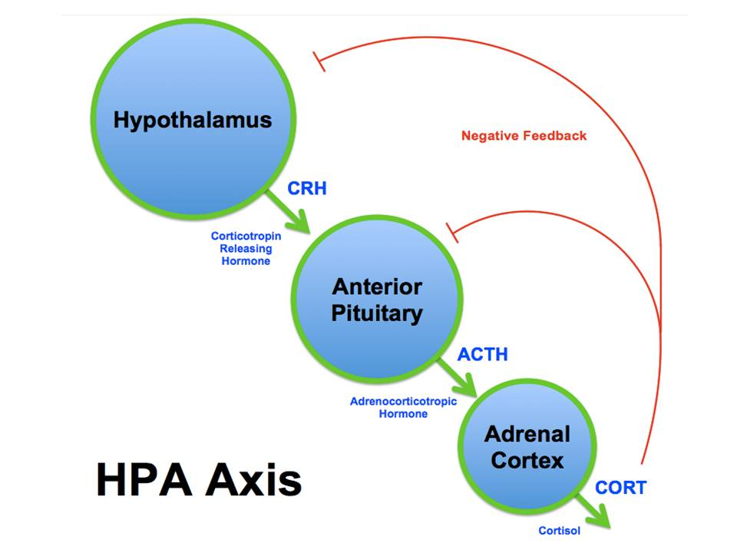
Stress response
HPA Axis
STRESS
HPT Axis
Hormonal cascade
mediated by hormones
But linked to autonomic nervous system too
Posterior
Pituitary
Thyroid
Notes:
HPA axis and the autonomic nervous system) (ANS) this overactive stress response puts you in a permanent state of ‘fight and flight’– both the (sympathetic dominance’ or even freeze (dorsal vagal parasympathetic) which combine to shut you down physically. Via hormones glutamate, noradrenaline, cortisol and dopamine.

Slide 7
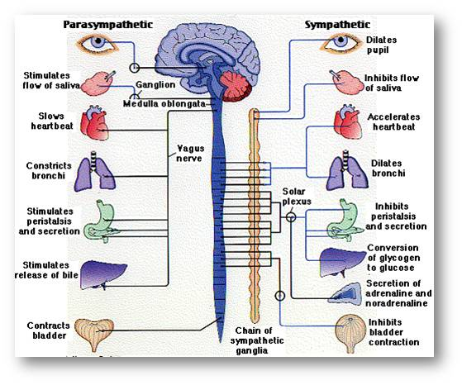
Autonomic Nervous System seat of being
Linked to autonomic nervous system (ANS) automatically controls our essential functions (including survival) without our conscious involvement
But it’s a bit more complicated than that…
Notes:
The traditional 2-sided model of PNS and SNS. Autonomic nervous system responds to signals from the limbic system and brainstem. Traditionally this was explained in terms .
of the para and sympathetic nervous systems. Fight and flight vs rest and digest– but it is more complicated
Mitochondria respond to these signals with the cell danger response and fatigue and pain result.
Reversing the message of threat is the biggest task we face to recover. But let’s look in more detail at the signalling mechanism; the newly discovered parts of the ANS – the polyvagal system.

Slide 8
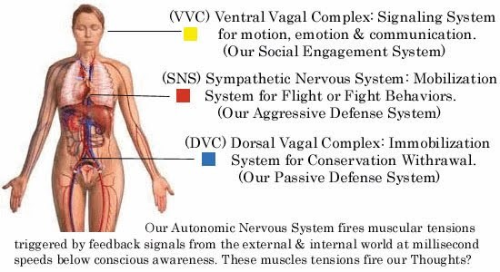
Polvagal theory 3 neural systems
In response to threat
Is a hierarchy of systems:
Social engagement
Fight, flight
Freeze
If system above is compromised, system below is activated
Stress can be unconscious
See work of Stephen Porges
Notes:
But this all changed when Stephen Porges identified a 3rd system, part of the parasympathetic system which was a lot older, from reptiles. This he called the dorsal vagal system and it’s response is to shut you down i.e. the freeze response. So we have a 3 tier system. With stress or trauma the mindbody tries to activate the most suitable system to get you out of danger. Each level is defaulted to when one above fails.
Think of a child who is emotionally stressed; firstly they turn to mum or a loved person to seek reassurance, if that fails
They get aggressive and try to fight or flee the problem – but with young children this is seldom successful or possible in some cases.
Finally they go inward (and reject contact preferring to seek their own company) - see examples from the classic ‘strange situation’ experiments)
But this also applies in adulthood too, especially when trauma reappears eg illness, accident.
This final level is profoundly disabling, being akin to a ‘living death’ when constant. But it builds slowly as the other systems gradually fail to solve the problem.

Slide 9
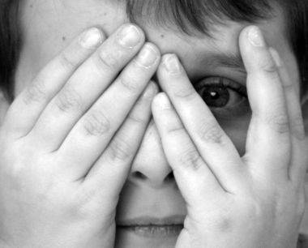
Stress The biggest killer?
Heart disease
Cancer
1. Adverse Childhood Experience (ACE) i.e. trauma
“triple the lifetime risk of heart disease and lung cancer and a 20-year difference in life expectancy”!!
(See TED talk Nadine Burke Harris and the work of Niki Gratrix. Also my study…)
Notes:
Trauma is many things… [list]. But it is not just the big events in your life but the small ones too. Cumulative stresses, like illness (of yourself or a loved one), lack of meaning, feeling ‘wrong’ or shameful, the list goes on and on. It is anything that you perceive in a state of helplessness.
i.e. childhood which is then triggered later on in life.
ACE study of 17500 people
Has huge effects which are not discussed /understood by modern medicine which is divided into physical and mental health divisions. There is no mindbody link in current medical practice.

Slide 10
Adverse Childhood Experience (ACE)
Difficult pregnancy or birth
Anxious, depressed mum – poor attachment
Alcoholism/ Addiction/Violence in the home
Sibling rivalry/ bullying
Moving home / schools or being sent away
Chronic illness esp. with hospitalisation (separation)
60- 70% of people have one or more – mindbody interprets this as a survival threat and changes stress response to be more easily triggered (kindling) through changes in the limbic system of brain

Slide 11
Polyvagal theory Attachment
Poor attachment to mother causes huge changes in the developing brain of the child (developmental trauma)
Linked by eye contact, touch, sound (voice), etc to help brain develop a sense of internal safety, and emotional regulation
When mum is distracted, absent, triggered herself this can fail and lifelong changes in the brain happen.
Very underreported and often missed as a cause of disease (45% of babies are insecurely attached) which makes them:
Avoidant
Anxious (ambivalent)
Notes:
Can be measured by Adult Attachment Interview see Nikigratrix.com

Slide 12
Poor attachment
Affects growth (development) of brain (neural pathways)
We are social creatures, brains don’t develop in a vacuum they do so in response to their environment – absence of love and connection changes brains of children and adults
Has huge implications for adult life: relationships, mood (emotional) regulation, concentration, learning problems, anxiety (esp. social)
Like PTSD but is ambient, repetitive trauma
An absence of calm, security and a trigger to development of disease

Slide 13
Polyvagal theory: response under threat
Stimulus
Behaviour
Threat*
Social Engagement
Flight and Fight
Shut-down/ freeze
*absence of something that the organism perceives as necessary for survival—or its threatened loss

Slide 14
Stressful experience (emotional trauma) landscapes the brain and changes the mind and body – for life* *unless mitigated
Your emotional brain: Limbic system
Notes:
Meet your emotional brain [describe]
Stress and trauma landscape (change) the brain.
Especially early (childhood) trauma)
Bits grow (amygdala) and some bits shrink (hippocampus and frontal lobes) and because your deep emotional brain (limbic system) talks directly to your body via the

Slide 15
Trauma?
A perceived threat that happens when helpless to an already sensitised brain. The meaning we attribute to the event not the severity of the event itself.
formed early in life (0 - 7): completely unconscious
Changes the perception of self (sense of shame/ wrongness) and the ability to self-soothe and regulate our emotions (we become hyper-sensitive to stress) or we numb out (anxious or avoidant)
Profound disconnect to ourselves and others
Difficulty being in the here and now – freeze response
Notes:
Trauma is many things… [list]. Accident and Bereavement would be top of most people’s list. Birth too can be traumatic if surgical and the mother is stressed. The effects on the baby (child/adult) are lifelong.
But it is not just the big events in your life but the small ones too. And it is not just a rare, unusual event. Cumulative repetitive stresses, particularly of interpersonal relationships like bullying and betrayal are particularly important. And of course illness (of yourself or a loved one) is a huge trauma particularly when you are seemingly unable to help yourself. Surgery, particularly where it involves restraint (and that includes dental surgery especially with ether). In fact almost anything that happens when helpless can be traumatic; lack of meaning, feeling ‘wrong’ or shameful, the list goes on and on. It is anything that you perceive in a state of helplessness. i.e. childhood which is then triggered later on in life.

Slide 16
Sensitivity an extra issue
This ‘freeze’ response becomes the default pathway
Especially if ‘sensitive’ (HSP - a highly sensitive person – 20%), this becomes part of our personality and can cause us to hide out, avoid certain situations (anxiety/ phobias/ etc) or
Becomes buried in unconscious symptoms in the body:
Pain
Fatigue
Auto-immune disease
That which is inexpressible becomes expressed in the body – the ‘symptom imperative’. The Body Keeps the Score
Notes:
So freeze can become the default pathway if;
The child is sensitive and has small ‘t’ or large ‘t’ trauma of some sort.
This affects the body by causing shut down of non-essential systems like creative play, imagination, planning and empathy.

Slide 17
Mind and Body are one
‘Psycho-neuro-immunology’ (PNI)
Emotions are felt in both the mind and body
But not all emotions are the same, some are more damaging than others e.g. shame, betrayal, fear are profound landscapers of the brain.
Linked to overwhelming life events/ trauma.
Notes:
Emotions are body states not just mind. Preparing you for movement = emovare to move.
Trauma or emotional memory is implicit (wordless recording) of an emotionally charged event
Initiated in childhood and then triggered in later life.
Now I have an explanation for that event in my massage clinic 5 years ago…
In this sense time does not heal. These messages of imminent threat are permanent and persistent and stuck in the now.
They do not decay and they are not subject to analysis because they are subconssious and wordless. They have to be approached through the body

Slide 18
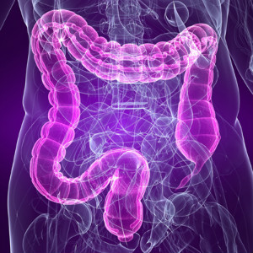
The mind outside the brain: gut brain
The gut-brain or ‘enteric’ brain
Gut has its own nervous system AND
the ‘microbiome’ (bacteria, fungi, etc)
Outnumber your own cells 10:1
Your DNA 100:1
You are an ecosystem!
Gut microbes pick up hormonal, neurological messages.
Toxins, both external and internal create havoc

Slide 19
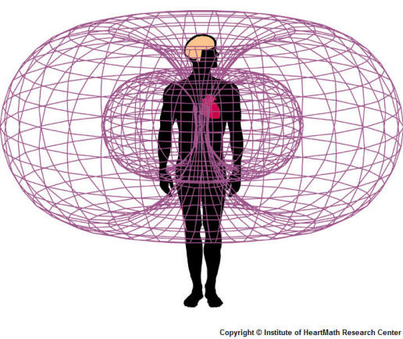
The Heart-Brain Heart as emotional organ
Basis of wellbeing – heart intelligence
Has its own electromagnetic field (60x brain), nerve connections
feels and senses things before the brain, especially emotional connection
Is responsible for entraining the brain (entrainment occurs between people, you and your pets and the earth)
Notes:
The heart generates the largest electromagnetic field in the body. The electrical field as measured in an electrocardiogram (ECG) is about 60 times greater in amplitude than the brain waves recorded in an electroencephalogram (EEG).”
Pre-alerts you to future events (Not linked to space-time)
Through the use of tools and technologies that foster positive emotions and psychophysiological coherence, individuals can effectively initiate a repatterning process, whereby habitual emotional patterns underlying stress are replaced with new, healthier patterns that establish increased emotional stability, mental acuity, and physiological efficiency

Slide 20
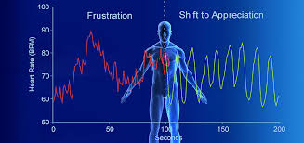
The Heart-Brain Heart Rate Variability
A measure of health – beat to beat variation between heart beats
Linked to vagal tone (vagal brake)
Should have high variability
Demonstrates how heart and brain are coordinating – most heart to brain signalling.
Low HRV is an ‘Early warning indicator’ of ill-health
Reduces self-regulation
See work of HeartMath Institute – & Inner Balance app
Notes:
Interspike intervals often contain coded information
Most (80%) signals pass from heart to brain not other way round
If it is low it affects the ability of the thalamus to co-ordinate cortical activity resulting in reductions in social and situational awareness, the capacity to care and ability to self-manage (regulate).

Slide 21
Toxicity: The stress connection
Internal toxins
from liver detoxification processes
free radicals formed in mitochondria during energy production. If you don’t have enough anti-oxidants they wreak havoc
3. Stress – causes inflammation throughout body – inflammatory chemicals circulate in the blood - cortisol
Toxic (negative) thoughts / beliefs are just as damaging as external toxins.
Notes:
As part of Phase I detoxification many chemicals are initially made more toxic before being conjugated.
If you are a poor detoxifier (genetic) you struggle with this
Cortisol is a profoundly damaging hormone when released long term (it is meant to be a temporary state of affairs); stokes the inflammatory fire of cytokines, IL-F, etc.

Slide 22
Emotional cleansing
Foster emotional competence:
Identify current needs
Establish clear boundaries
Clear past emotions with psychosensory/ energy therapies:
EMDR, EFT (tapping), havening, therapies: hypnotherapy, bodywork
Cultivate a life of (neural) safety - nurture yourself with:
Yoga, meditation, music, hypnosis, holosync
Creative expression
Prioritising being over doing, love over fear
Getting in the ‘flow’ changes your brain waves to slow alpha .. These are healing states.
Notes:
Demo havening. Describe psychosensory..
Safety is the absolute priority for healing. To encourage bodily safety takes time but havening does it best.
Many ways to cultivate that life [list] but creative expression is the key – find what lights you up and feeds your soul and do more of it.
Become a human being again not a human doing. Make connection your priority along with gratitude and (self) forgiveness.
You brain waves change when you do these things and congruence harmonises your energy.

Slide 23
Chronic fatigue, pain and auto-immune syndromes
These are 21st century epidemics caused by:
Toxicity of the food supply and environment (pesticides, antibiotics hormones)
Nutritional deficiency
Chronic stress* and unresolved childhood trauma
Emotional isolation and lack of support
Personality type – driven, people-pleasing. etc. Ignoring your own needs to manage your life as others expect of you
three factors that universally lead to stress: uncertainty, the lack of information and the loss of control- all are present in chronic illness

Slide 24
Recovery from chronic illness
Work with a practitioner to assess and improve your psychological and physical health
Address:
nutritional and hormonal deficits (adrenal/thyroid)
unmet emotional needs/ pain (EFT, EMDR, energy healing)
improving energy metabolism
disconnecting from the old belief systems of lifelong ‘managing’/ disability consciousness with wellbeing coaching.
Notes:
Forgiveness here of course does not mean condoning his mistreatment of her but of letting go of the emotional burden from her mind (and body)

Slide 25
Polyvagal theory:
Safety at the heart of healing
Safe
Social Engagement
Play/ creativity*
Love/ intimacy**
*mobilisation without threat **immobilisation without threat

Slide 26
Healing
Enjoy and appreciate - changes your brain towards positivity rather than problems
Cultivate kindness and compassion- especially with those who irritate and hurt us. Start with yourself and your self-talk – enhance self-worth so you stop sabotage
Avoid a victim mentality - becomes a mental habit - life reflects this back. Become ‘miracle-minded’ and cultivate positivity
Find meaning and purpose: volunteer, get active in something esp. the needs of others - improves longevity.
Avoid negativity – whether from news, people, organisations and actively choose positive people, situations, and jobs when possible.
Notes:
Get involved in acts of appreciation and giving as a part of your daily life. I make a point of mentally thanking the good things in my life when I wake each morning. This may sound rather trite but it has the effect of changing your brain towards positivity rather than looking for problems which is how most people are most of the time.
Cultivating kindness and compassion; this is harder especially with those who irritate and hurt us. But you can start with yourself and your self-talk. Watch and note how you talk to yourself; it’s likely very negative and derogatory. Remember this does not build our self-worth and it is with ourselves that love begins. Once you learn to be kinder to yourself it becomes easier with others. People who hit out often do so because it matches what they feel about themselves.
Work on your mindset as it has everything to do with the trajectory of your life (both morbidity (illness) and mortality). If you have a victim mentality it becomes a mental habit to always see things in this light and your life will then reflect this back to you. Become ‘miracle-minded’ and cultivate positivity, mindfulness has a great part to play in this.
The more you activate drive and will towards finding meaning and the needs of others i.e. something that transcends your own experience, the more focused you become on connection which is one of the most profound indicators of longevity. Volunteer, get active.
Avoid negativity – whether from news, people, organisations or whatever and actively choose positive people, situations, and jobs when possible. Sometimes this will be about changing your job or friendship network; other times it could be as simple as signing up to a positive news channel.
Change your world view towards resolution not problems i.e. a ‘things will get better’ mentality. The microbiome picks up this message. How you do this is covered in more detail in my first book, but it often involves clearing old belief systems Lack of self-worth will override any dietary changes you make and will eventually mean you abandon them. Looking at your emotional health is supremely important. See my previous book ‘The Scar that Won’t Heal’

Slide 27
Thank you for listening
Any questions?
My books ‘The Scar that won’t Heal;
Stress, Trauma and Emotion in Chronic Disease (now)
and ‘The World within; how your gut microbes
make you who you are’ (out soon)
Available on amazon…
Signed copies £10

Slide 28
Demo if time
EFT

Slide 29
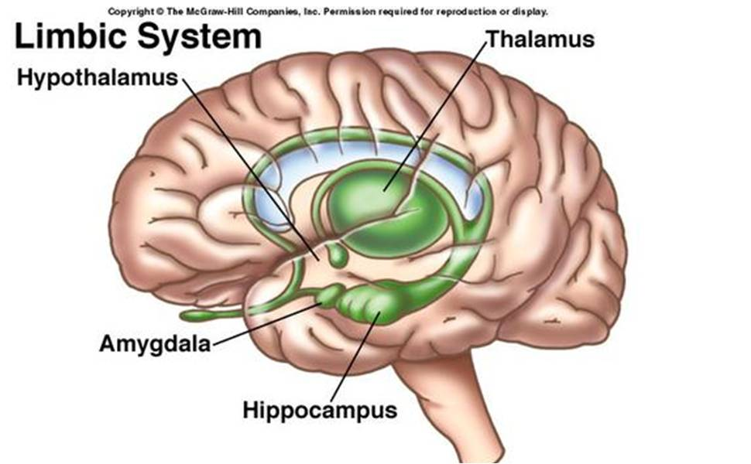
The Emotional Brain; limbic system and brainstem
Insula
Hypothalamus – stress response
Amygdala = smoke alarm
Insula – relay station, sensory processing, empathy
Thalamus = ‘cook’, sifts data
Hippocampus = context stamp & memory encoding
Notes:
Origin of unconscious control and feedback of body and mind. Usually in balance with PNS and SNS but with constant stress or trauma/ survival mechanisms (ventral PNS and SNS are activated most of the time.
Introduce you to some special part of the unconscious brain that have a particular role in stress and trauma.
Hypothalamus is the stress response initiator. HPA axis. Highly activated in trauma.
Amygdala is the smoke alarm, highly tuned to pick up danger signals (or what is unfamiliar). Highly activated
Thalamus is the cook which sifts through incoming data from environment and mixes it together into an autobiographical ‘soup’ –switches off during trauma (and recall) which is why dissociation and flashbacks occur. Deactivated.
Hippocampus is the ‘librarian’ or ‘context stamp’ – memory encoding and retrieval. If ‘offline’ as during trauma memories are stored implicitly as fragments rather than in context. Hence traumatic memories are disjointed, incomplete, or lacking content other than sense feeling. We can even be completely amnesic for the event itself!
Cortex goes offline during trauma and unconscious recall. So we can’t think logically or use our brains to organise our experience. We are highjacked!
Insula – Relay station for information around body – where ‘mind and body meet’. Wellspring of social emotions. Is also offline during trauma so we feel disconnected from our bodies origin of ‘out of body experience’
Worth noting that the prefrontal cortex is inhibited when the stress response is activated. Hence we find it difficult to make decisions, think clearly and discern logical action.

Slide 30
How to heal - techniques
Investigate /explore – ACE scores, Adult close relationship questionnaire*, Adult adjusted interview score + Awareness can help
Bodywork (emotions are stored in the body) e.g. somatic experiencing (SE TM)
Enneagram (personality types)
Look at emotional healing:
EFT
EMDR
Havening
Access consciousness, rebirthing (breathing), flower essences, homeopathy, journalling ,etc, etc
Notes:
See nikigratrix.com
+Dan Siegel’s website

